Slide 1
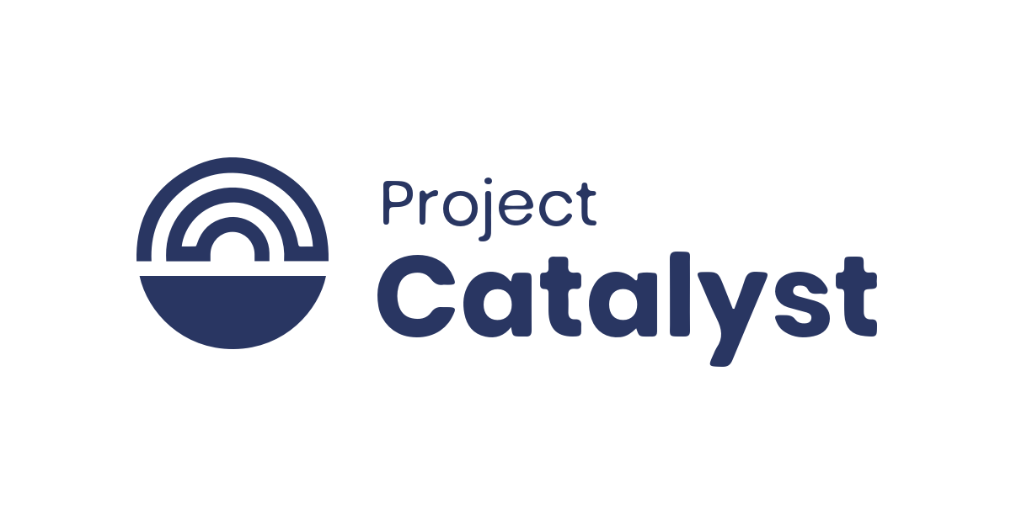
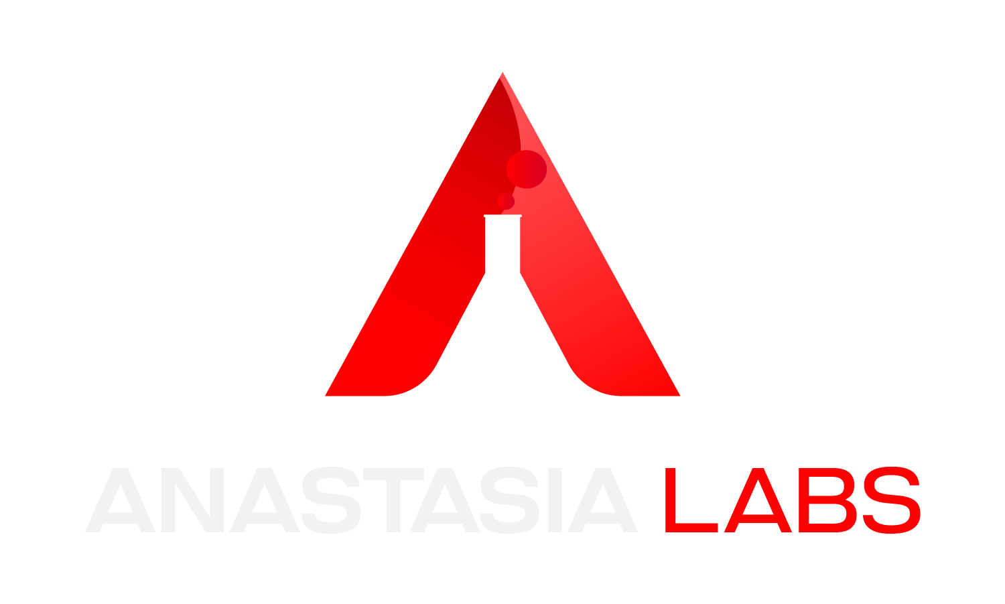
Fund 11
High Quality Japanese Translations for Popular Cardano DApps

Slide 2
Challenge
To reduce the language barrier for Japanese ADA users
To reduces risks associated with misinterpretations in DeFi transactions
Proposal Objective
Designed to increase engagement of Japanese ADA holders in the Cardano ecosystem and to increase liquidity in Cardano DApps

Slide 3
List of Cardano DApps TranslatedLi
DJED
Liqwid Finance
Lace Wallet
SundaeSwap
Minswap
OptimFi
Encoins

Slide 4
Availability of Translations
DJED - https://github.com/Anastasia-Labs/high-quality-japanese-translation/blob/main/Milestone1/djed-website-words.pdf
Liqwid Finance - https://github.com/Anastasia-Labs/high-quality-japanese-translation/blob/main/Milestone1/liqwid.pdf
Lace Wallet - https://github.com/Anastasia-Labs/high-quality-japanese-translation/blob/main/Milestone1/lace.pdf
SundaeSwap - https://github.com/Anastasia-Labs/high-quality-japanese-translation/blob/main/Milestone2/sundaeswap.pdf
Minswap - https://github.com/Anastasia-Labs/high-quality-japanese-translation/blob/main/Milestone2/minswap.pdf
OptimFi - https://github.com/Anastasia-Labs/high-quality-japanese-translation/blob/main/Milestone3/Optim%20-%20Website%20Translation%20Japanese.pdf
Encoins - https://github.com/Anastasia-Labs/high-quality-japanese-translation/blob/main/Milestone3/encoins-website-words-japanese.pdf

Slide 5
Impact on Cardano Community
Long-Term User Growth
Reduction of Risk
Enhanced Global Image
Scalable Model

Slide 6
Conclusion
Directly addresses a community need
Increases DApp Liquidity

Slide 7
Thank You
For more information, visit our GitHub repository at:
https://github.com/Anastasia-Labs/high-quality-japanese-translation
If you want to know more about Anastasia Labs or contact us, you can visit
- Our website at https://anastasialabs.com/
- Follow us on twitter at https://x.com/AnastasiaLabs
- Join our discord community: https://discord.com/invite/8TYSgwthVy

